Slide 1
6th International Conference on Natural Science and Technology
(ICNST)
29 – 30 March, 2019
Paper ID: 0.ICT.005
RISK PREDICTION OF STROKE USING DATA MINING CLASSIFICATION TECHNIQUES
Authors Name : Rahatara Ferdousi
M M Faniqul Islam
Masum Mohammad Jubayel
Asima Akter Chowdhury
Presenting Author : Asima Akter Chowdhury
Affiliations : Computer Science and Engineering,
Metropolitan University
Sylhet, Bangladesh

Slide 2
Paper Content
Introduction
Related work
Objectives & Contribution
Dataset details table
Flow chart of Methodology
Mathematical Representation of Methodology
System Architecture
Result
Proposed Tool
Conclusion & Future Scope
References

Slide 3
Introduction
What is Stroke ?
A stroke occurs if the flow of oxygen-rich blood to a portion of the brain is blocked [1]
Role of risk factor of stroke for prediction:
The more risk factor a patient has, the more chances to have a stroke [2]
Data mining for risk prediction model: Data mining classification techniques like- NB, SVM, ANN, J48, RF, RT, LG are using for reliable risk prediction of disease due to having the capability of finding hidden of relevant data.
Risk factor can be controlled [3]

Slide 4
Related work
Paper Name | Author Name | Dataset information | Used data mining techniques | Obtained accuracy
STROKE RISK PREDICTION THROUGH NONLINEAR SUPPORT VECTOR CLASSIFICATIONS MODELS | Sabibullah Mohammaed Hanifa and Kasmir Raja S.V | 100 data with 8 attributes | Confusion matrix (RBF and polynomial) | 98%, 92%
PREDICTION OF STROKE USING DATA MINING CLASSIFICATION OF STROKE | Ohoud Almadami and Riyad Alshammari | 969 data | C4.5, Jrip and multilayers perceptron | 92.60%, 95.25%
ASSESSMENT OF STROKE RISK BASED ON MORPHOLOGICAL ULTRASOUND IMAGE ANALYSIS WITH CONFORMAL PREDICTION | Antonis Lambrou, Harris Papadopoulos | 6 features | ANN, NB, SVM, and K-NN | 98%
A MODEL FOR PREDICTING ISCHEMIC STROKE USING DATA MINING ALGORITHMS | Balar Khalid and Naji Abdelwahab | 265 data | C4.5 DT algorithm and Logistic regression | 77.58% , 83.03%

Slide 5
Objectives & Contribution
To prepare an appropriate dataset of risk factors
To use the most popular risk prediction data mining algorithm for the dataset
To obtain the best algorithm
To design an end-user tool (website)
for mass people with the
*checking feature developed with the best algorithm.

Slide 6
Dataset details table
Description of attribute
Attributes | Values
Age | 1.25-34, 2.35-44, 3.45-54,4.55-65,5.65<
Gender | 1. Male 2. Female
Systolic BP | 1.120>, 2.120-139, 3. 140-160, 4.160<
Diastolic BP | 1.80>, 2.80-95, 3.95<
Diabetes | 1. No, 2. Yes
Ischemic Heart Disease | 1. No, 2. Yes
Family History of stroke | 1. No, 2. Yes
Alcoholism | 1. No, 2. Yes
Less Physically Active | 1. No, 2. Yes
Smoking | 1. No, 2. Yes
Stress and depression | 1. No, 2. Yes
Saturated Fat↑ () | 1. No, 2. Yes
Fibre↓ () | 1. No, 2. Yes
Chronic Kidney Disease (CKD) | 1. No, 2. Yes
Class Attribute | 1. Stroke, 2. Non-stroke
Description of the training dataset
 | Number of Attributes | Number of Instances
Report based dataset | 15 | 435

Slide 7
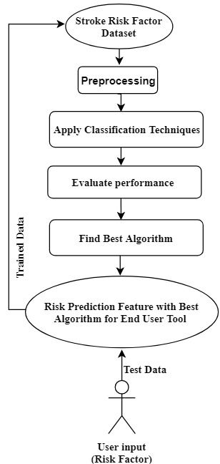
Flow chart of Methodology
Fig. 1. Flow chart of Methodology

Slide 8
Mathematical Representation of Methodology
In this section we gave a description about our methodology.
Input: Risk factor test dataset.
Output: Predicted risk level, suggestions and tips.
Let,
Risk_algorithm, A;
Performance_accuracy, Acc;
Now,
T_{train} = T_{n} - T_{φ} (1)
Where,
T_{train} represents train data, T_{n} represents the total number of instances and T _{φ} represents missing tuple.
Acc = A (T_{train}, T_{test}, R_{n}) (2)
Where, T_{test} represents test data and R_{n} represents the total number of risk factors.
best_accuracy = max (Acc_{i}) (3)
Here, i is the number of algorithms used for prediction and simulation process.

Slide 9
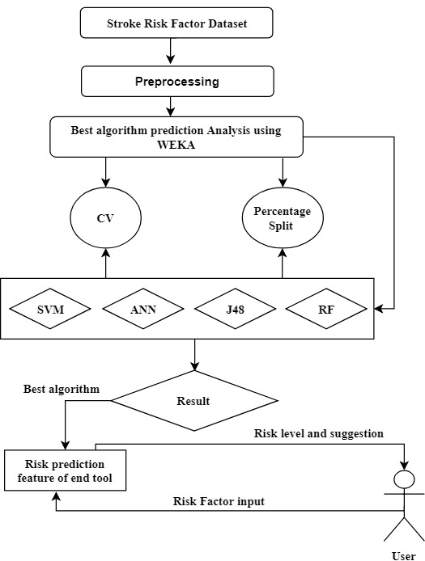
System Architecture
Fig. 2. Proposed System architecture

Slide 10
Result
The results are retrieved using the data mining tool Weka(3.8) and evaluated with 10-fold Cross validation and Percentage Split method.
Accuracy table
Algorithms | Accuracy Found with 10-fold cross validation | Accuracy found with Percentage Split Method
Naïve Bayes | 79.31% | 79.31%
Random forest | 82.29% | 78.16%
J48 decision tree | 83.91% | 80.46%
Logistic Regression | 80.92% | 77.01%
Artificial Neural Network | 81.15% | 79.31%

Slide 11
Comparison of evaluation metrics using 10-fold cross-validation and percentage split (80:20)
Evaluation Metrics | 10- Fold Cross Validation |  |  |  |  |  |  | Percentage Split (80:20)
 | NB | SVM | LG | J48 | RT | RF | ANN | NB | SVM | LG | J48 | RT | RF | ANN
Total number of the instance | 435 | 435 | 435 | 435 | 435 | 435 | 435 | 87 | 87 | 87 | 87 | 87 | 87 | 87
Correctly Classified Instance % | 345 | 342 | 352 | 365 | 332 | 358 | 353 | 69 | 66 | 67 | 70 | 65 | 68 | 69
 | 79.31 | 78.62 | 80.92 | 83.91 | 76.32 | 82.29 | 81.15 | 79.31 | 75.86 | 77.01 | 80.46 | 74.71 | 78.16 | 79.31
Incorrectly classified instance | 90 | 93 | 83 | 70 | 103 | 77 | 82 | 18 | 21 | 20 | 17 | 22 | 19 | 18
 | 20.69 | 21.38 | 19.08 | 16.1 | 23.68 | 17.7 | 18.85 | 20.689 | 24.14 | 22.989 | 19.54 | 25.29 | 21.84 | 20.69

Slide 12
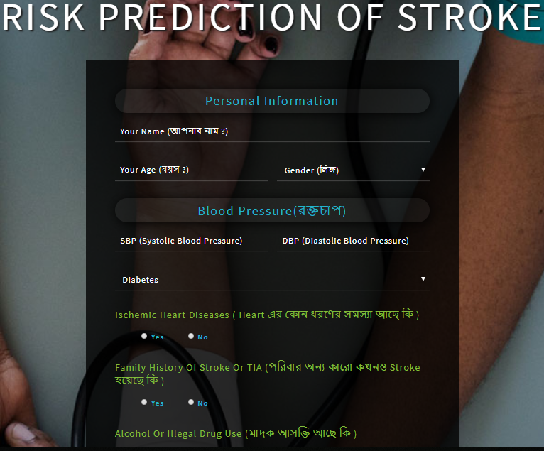
Proposed Tool

Slide 13
Conclusion & Future Scope
Conclusion:
1. A proper analysis of the relevant dataset to obtain the prediction method of best accuracy a reliable prediction tool is required.
Future scope:
1. Deploying a website or mobile apps developed using J48 method for mass people can be considered as the future scope of this work.
2. Regularly updated data from the user in the system will enrich the dataset.
3. Analysis of real system performance can also be conducted.

Slide 14
References
[1] National Heart, L. a. B. I., n.d. National Heart, Lung, and Blood Institute. [Online]
Available at: http://www.nhibi.nih.gov/health-topics/stroke
[Accessed 3 January 2019].
[2] National Heart, L. a. B. I., n.d. National Heart, Lung, and Blood Institute. [Online]
Available at: http://www.nhibi.nih.gov/health-topics/stroke
[Accessed 3 January 2019].
[3] National Heart, L. a. B. I., n.d. National Heart, Lung, and Blood Institute. [Online]
Available at: http://www.nhibi.nih.gov/health-topics/stroke
[Accessed 3 January 2019].

Slide 15
Any Query ?

Slide 16

Thank You !

